Slide 1
Syne User Management Framework
Quality Control
Author

Slide 2
Syne User Management Framework Overview
Course Content: (Session 1)
Introduction to Syne User Management Framework
How Syne User Management Invented and Why we need Syne User Management Framework?
Idea about framework components and coding standard
Input Unit
Processing unit
Execution Unit
Output Unit
Syne User Management Framework Architecture(High-level)
Challenges Faced by Syne User Management Framework
Syne User Management Striking Features

Slide 3
Syne User Management Framework Overview
Challenges Faced byVoice Claim SequenceAutomation Framework
Handled dynamic voice business nature by designing voice business modules customizable
Integration with different tools to support compatibility
Dynamic nature of business means that the automation frameworks need to be consistently researched, studied, and customized as per the new business landscape
Designing concurrently executable stored procedures, but still support atomicity.
Integrating voice services with business case rule engine
Continuous refactoring of the framework code to remove duplicity and making it maintainable
Load the application-specific library required for script execution and fetch the required details from automation database

Slide 4
Syne User Management Framework Architecture
Course Content: (Session 2)
Syne User Management Architecture Walkthrough
Detail Design Development and Functionality Understanding of each module
INPUT UNIT
Input unit consist of UML, Configurator, Server Xmls
INPUT TEST SCRIPT /FILE BUILDER
UI to build test script
PROCESSING UNIT
Loads Application Specific Library required for Script execution and fetch the required details from DB (Execution engine runs the script according to the workflow)
EXECUTION UNIT
Logs the Report to test management tool and creating HTML reports
OUTPUT UNIT
Output unit takes the output generated by Execution unit for the application and generates the results in the form of HTML/XML/Spreadsheets or the other formats specified in the Config files.
RULE ENGINE AND CENTRAL DB
Stores Object Repository, Stores Test Scripts in XML format, Stores Database queries, Stores UI Tools data to Design test cases
Test Management Interface
Software Interface adapter Module
Business Validation Flow

Slide 5
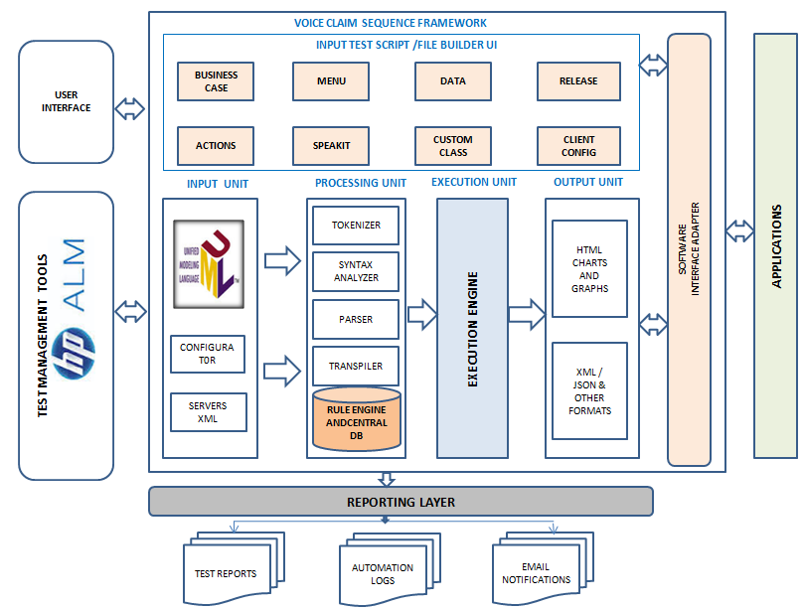
Syne User Management Architecture Walkthrough
Framework mainly consists of 8 sections, namely, Input Test Script File/Builder UI Module, Input Unit Module, Processing Unit Module, Execution Unit Module, Output Unit Module, Test Management Tool Interface Module, Reporting Layer Module, and Software Interface Adapter Module

Slide 6
Input Test Script File/Builder UI Component Walkthrough
Business Case
Menu
Data
Release
Action
SpeakIT
Custom Class
Client Config

Slide 7
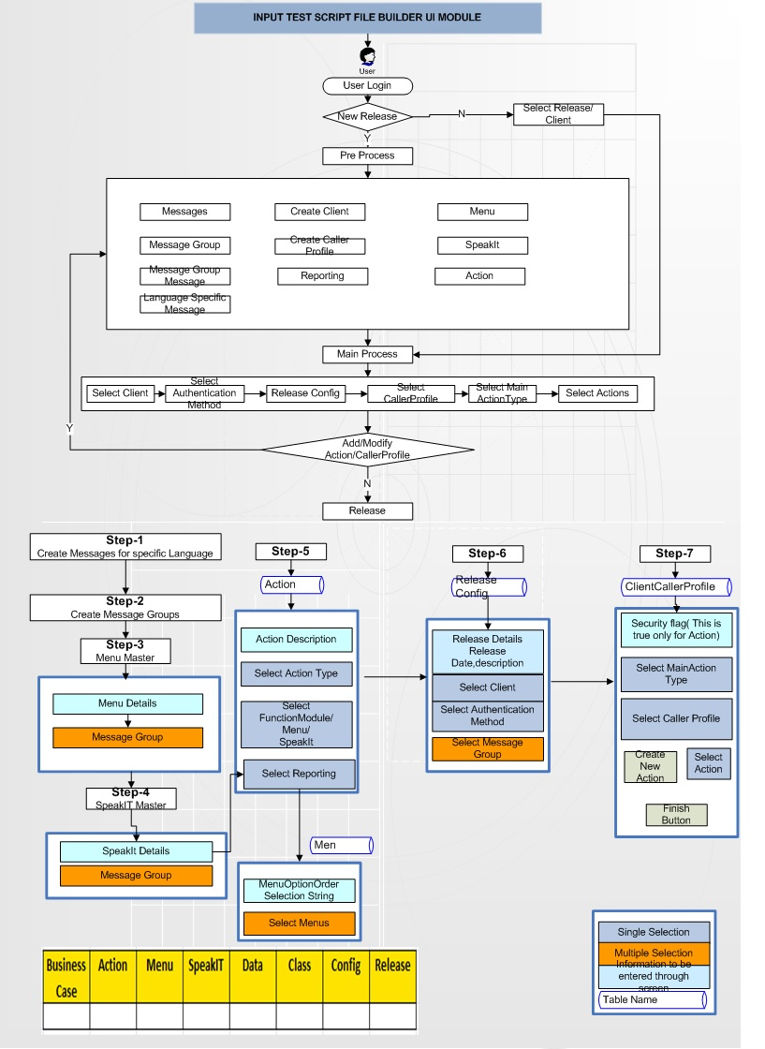
Input Test Script File/Builder UI Detail Design Discussion

Slide 8
Input Unit Component Walkthrough
UML Input
Sequence UML Diagram Pattern
Detail Discussion on Configurator
Platform
Automation .XML
ENV Configurator
Environmental.XML
Test Config
Test Script.XML
XML server

Slide 9
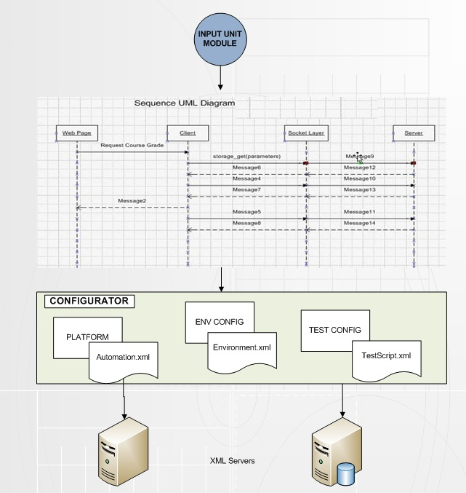
Input Unit Detail Design Discussion

Slide 10
Processing Unit Component Walkthrough
Processing Unit Module
PROCESSING Sequence
Tokenization
Syntax Analyzer
Parser
Transpiler
Technical Library
Rule Refinement Utility
Business Library
Rule Engine and Central DB

Slide 11
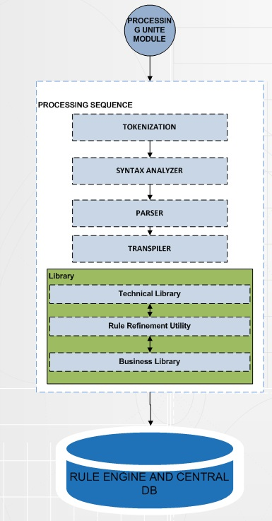
Processing Unit Detail Design Discussion

Slide 12
Rule Engine and Central DB Component Walkthrough
Middle Tier Web services
Syne User Management Wrapper Services
Get caller Profile
Feature Eligibility Services
Syne User Management Web Services
Rule Engine Wrapper Services
Role Engine Execution
Business Rules
Intelliset
Test Script
HS Enroll
Test Scenario

Slide 13
Rule Engine and Central DB Component Walkthrough
BBlogin
Enterprise and Address
Subscriber Cancellation
Digital Product Eligibility

Slide 14
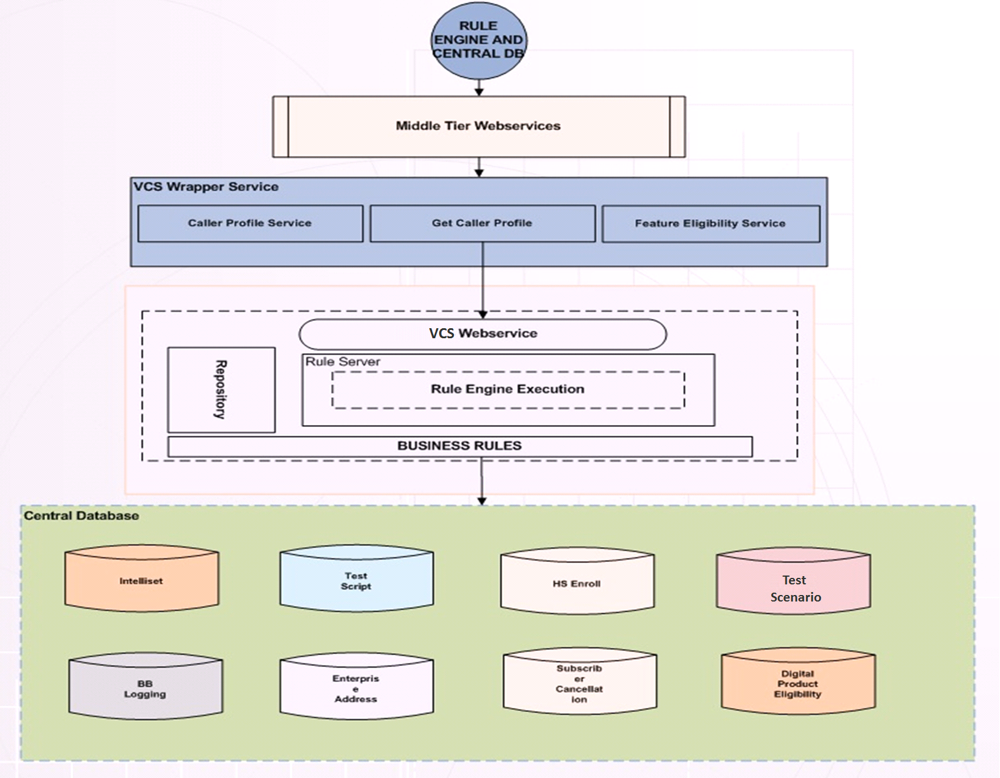
Rule Engine and Central DB Detail Design Discussion

Slide 15
Execution Unit and Output Unit Component Walkthrough
Execution Unit
Internal execution process with example
How single and multiple execution supporting by execution unit?
Average handling time to execute business case
Output Unit:
Detail discussion on different types of output format
Customization of output result

Slide 16
Execution Unit and Output Unit Component Walkthrough
Input Data
Expected data
Voice Business
Profile data
Test Script
Compare Actual expected data
XML Format
HTML Chart
Other Format

Slide 17
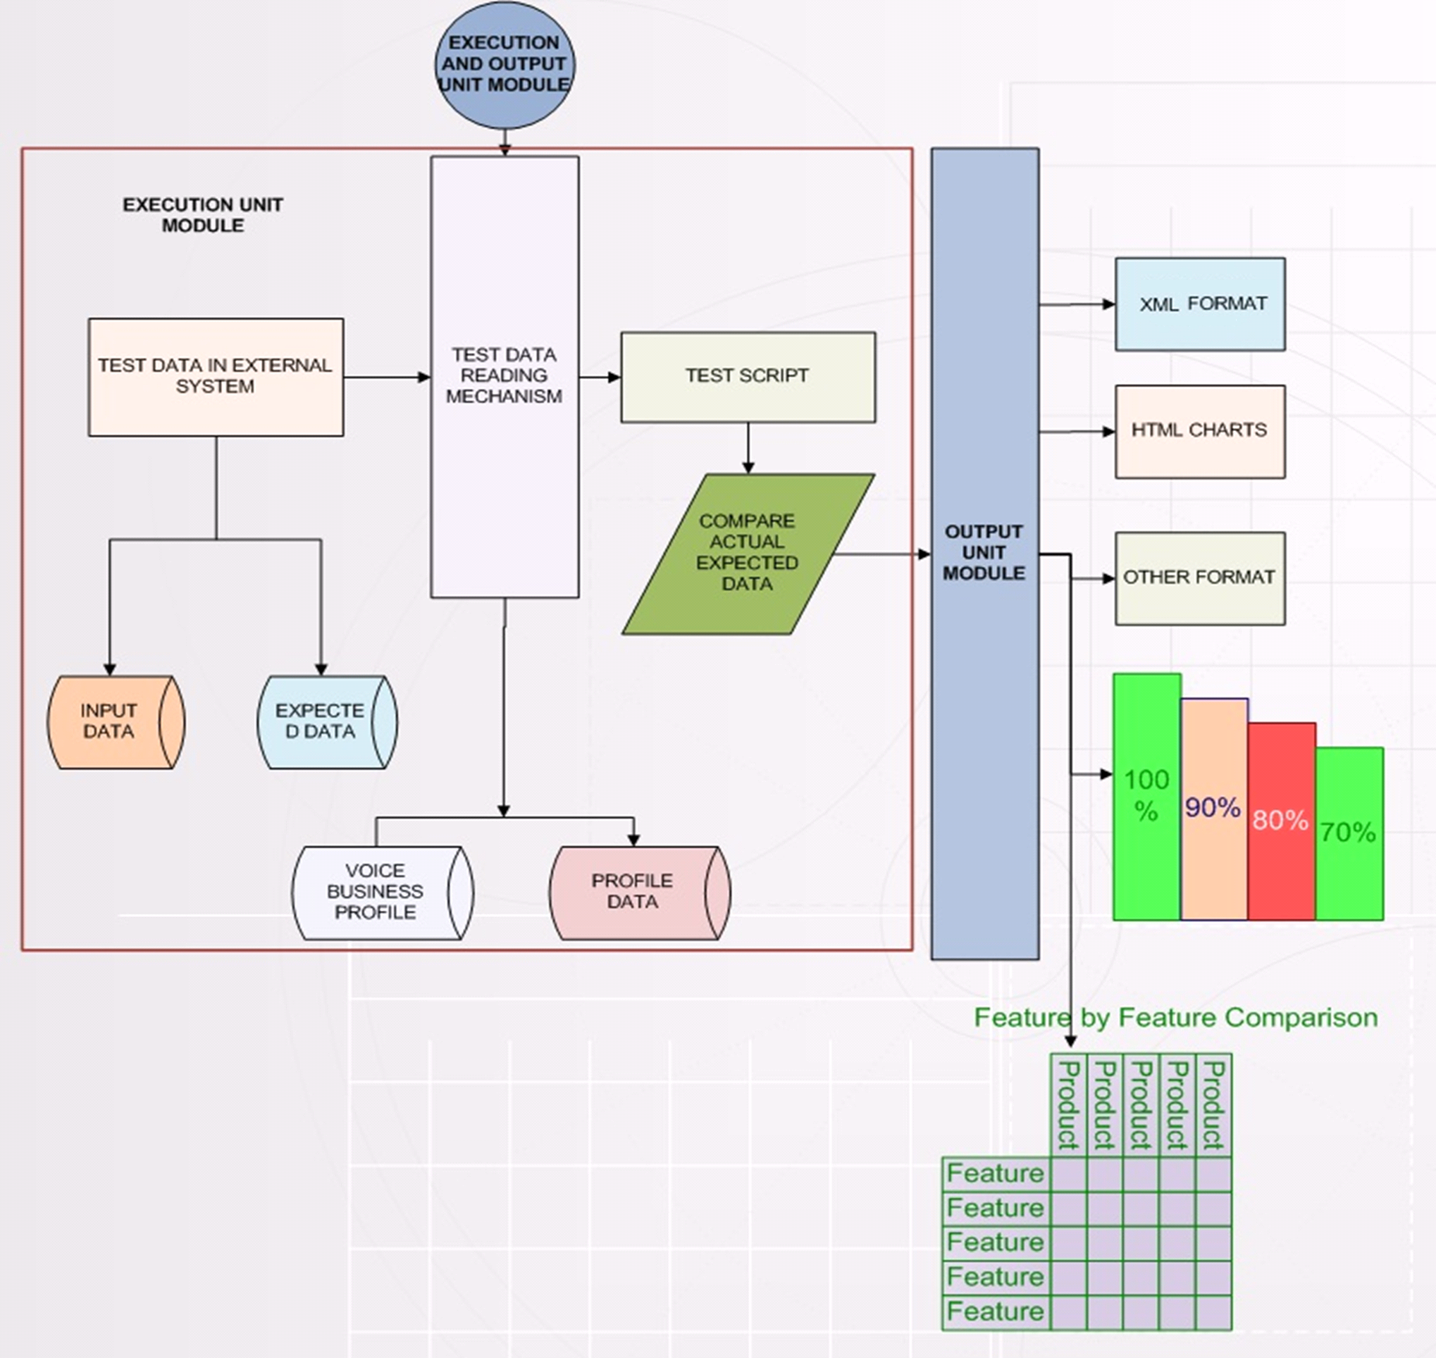
Execution Unit and Output Unit Detail Design Discussion

Slide 18
Reporting Layers Component Walkthrough
Discussion about different plug-ins
How to generate Historical report?
How to monitor real time voice channel report?
Procedure to customize different reports according to managements needs
Feature
Load
Monitoring
Sub Reports

Slide 19
Test Management Interface Component Walkthrough
Requirement Module: To track business requirements by linking each business case with designed test cases
Test Plan Module: To track the designed test cases and to maintain test cases repository
Test Lab Module: To track executed test cases pass/fail status
Defect Module: To track open/close/deferred/Invalid defect status
Scheduling test cases to be executed

Slide 20
Software Interface adapter Module Walkthrough
Interface adapter wrapper service mechanism
How Syne User Management can be integrated with other applications according to project requirements?
Pros and Cons

Slide 21
Business Validation Flow
Validating Entrance Flow: Enrollment Process, BAU, Forced Actions, Static Menu.
Validating Start Claim Flow: Regular Start Claim, Check-in Start Claim, Check-in Address Info, Check-in Peril, Check-in Peril Type, Check-in Accessory, Check-in Bill Shipping Confirmation, Check-in Get Contact Number, Verizon Bundle Codes, SUR (Same Unite Repair) Eligible flow.
Validating Finish Claim Flow: Peril Decision, Order Zip & Street Finish, Claim ATAC, ATAC Peril Decision, SUR Open Claim flow, Questions RE Replacement, Deductible.
Validating Payment/RMA Flow: Credit Card flows , COD, BTA,CC Finish, ATAC Credit Card flow, RMA Business Case, Extension Envelop Request, Refund Status, RMA Status Groups, Return Instructions.
Validating Hold: Black Listed Hold, Account Validation Hold, System Generated Hold, Equipment Back Order Hold, Document Hold, Shipping Hold, Subscriber Validation Hold.

Slide 22
Business Validation Flow
Validating Call Transfer: Contact Carrier, System Transfer, Error Transfer, Survey
Validating Actions:
Menus
Speak It
Dynamic Menus
Functional Module
Calltypes
Hang-up
Path Indicator
Survey
Checkout
Validating Audios and Others:
Dynamic configuration features for External API configuration (MT-External)
Cisco component configuration (Sub dialog)
Custom configuration

Slide 23
Syne User Management Input Test Script/File Builder UI
Course Content: (Session 3)
Introduction to Syne User Management Test Script UI
Syne User Management Test Script UI Menu Bar
Syne User Management Client Configuration Management UI
Configuration Management Page Purpose
View Client Configuration set in Production Env
How Stuff works ?

Slide 24
Introduction to Syne User Management Test Script UI
Test Script UI:
Used to configure the Dynamic Menus, SpeakITs, Calltypes, Initial Action for each OptionCode of particular client. Also we can push the release related new functionality added for specific client to QA.

Slide 25
Test Script UI Menu Bar
There are four different selections from the menu bar.
Master Items – This selection lists pages used to define or edit core components of the system. This includes Clients, Messages, Menus, SpeakITs, Functions, Caller Profiles and Reporting Information.
Menu Action – Displays a page that allows the definition of the actions associated with a menu.
Client Configuration – A page that allows the definition of the actions associated with a caller profile.
Release – Displays a page that allows the administrator to release call flow changes that have been made.

Slide 26
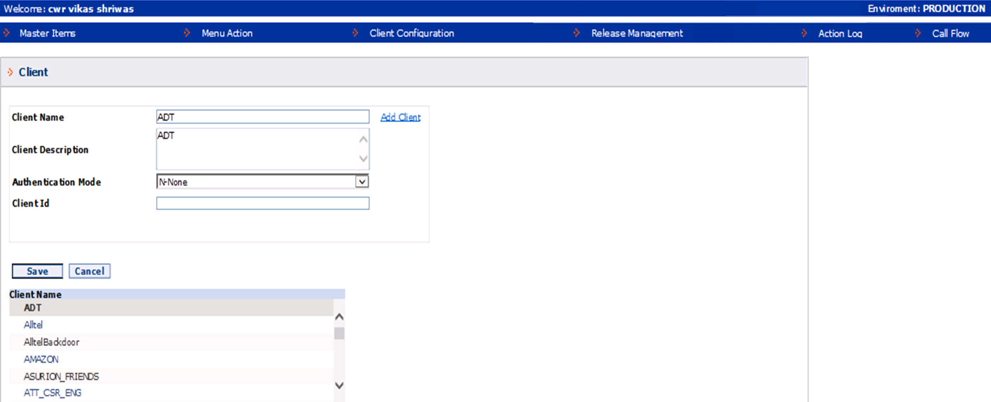
Test Script UI Menu Bar

Slide 27
Syne User Management Client Configuration Management UI

Slide 28
Configuration Management Page Purpose
This page is used to associate a Client/Caller Profile combination to an Action.
Definition of Terms:
Client – Wireless Carrier
Caller Profile – Caller Profile code represents a set of callers in a specific condition or scenario. For example; 2000 – Business Customer, 2005 – Open Claim and Payment Pending
Main Action Type – The Action performed will normally be the Initial Action. In some scenarios the initial action my be a SpeakIt or Functional Module that can then proceed to a Main Menu.
Action – Used to define the action that will be associated to the Client/Caller Profile.
Security Required – Flag used to indicate if security is required for this Client/Caller Profile.

Slide 29
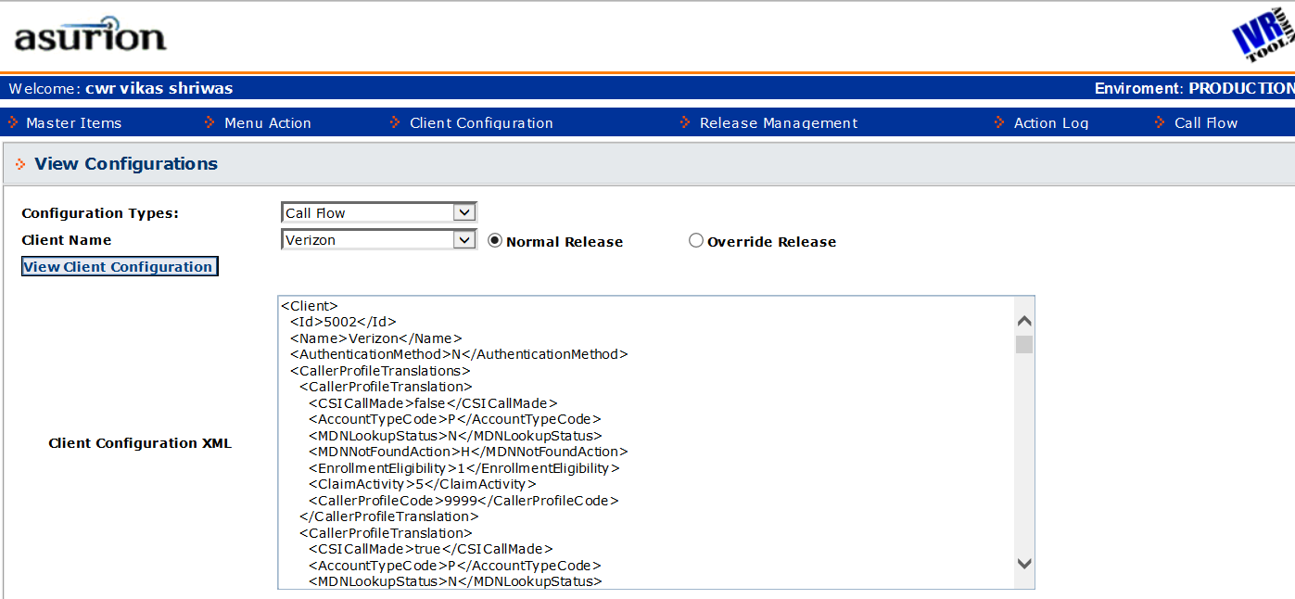
View Client Configuration set in Production Env

Slide 30
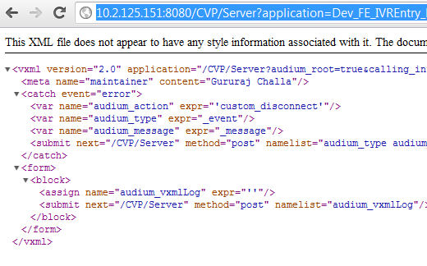

How Stuff works ?
Hit http URL with pass appropriate parameters
Response generated at the server is sent as xml page.
Parse generated XML to decide next URL to hit.
Input and other parameters are picked from the input configuration files
VXML Server
Syne User Management Framework

Slide 31
Syne User Management Tester/Execution Use Cases
Course Content: (Session 4)
Introduction to Use Cases and it’s purpose
Syne User Management Tester Use Cases
Syne User Management Voice Scenarios
Syne User Management Test Execution Use Case

Slide 32
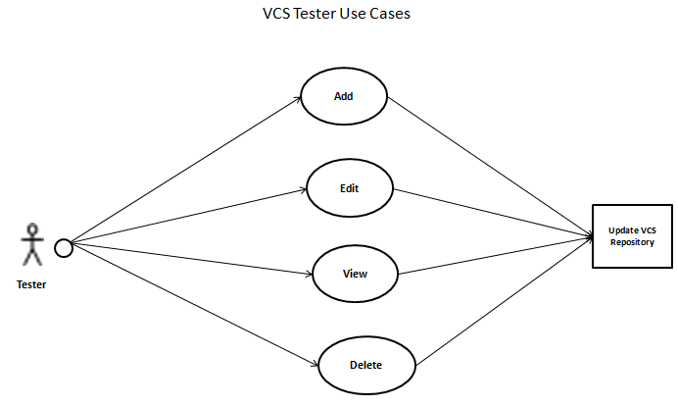
Syne User Management Tester Use Cases
Tester of the Syne User Management tool should be able to perform Add/Edit/Delete/View Test Cases, Tester will have a web-based form to enter the following details:
# | Field Name | Description
1 | BUSINESS CASE | Business Case node represents a set of callers in a specific condition or scenario.
2 | MENU | A menu is defined as a message that introduces a set of Actions that can be selected by a key press
3 | DATA | This is Test data value to be utilized by business case (Account number, locality etc.)
4 | RELEASE | This field selected to specify test script belongs to which release
5 | ACTIONS | This is name of method that performs specific set of actions
6 | SPEAKIT | A SpeakIT is a message followed by a defined Next Action
7 | CUSTOM CLASS | This field selected to specify test script belongs to which class
8 | CLIENT CONFIG | This field selected to specify test script belongs to which config set

Slide 33
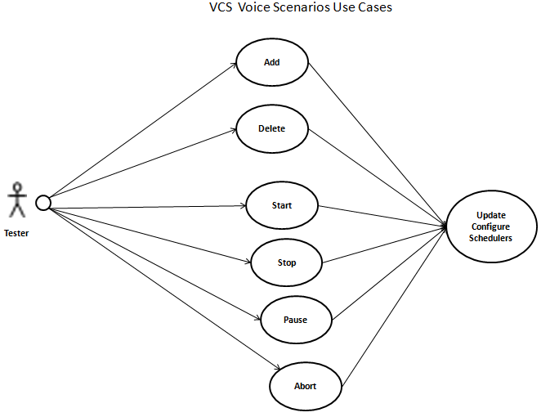
Syne User Management Scenarios Use Cases
Tester can create different client scenarios folder and can add/delete/start/stop/pause corresponding scenarios under
each clients, below fields need to be populated.
# | Field Name | Description
1 | Client Name | Scenario belongs to which client
2 | Environment | Scenario should run on which Environment
3 | Scenario description | Gives idea about scenario belongs to which flow
4 | Project Name | Scenario belong to which project

Slide 34
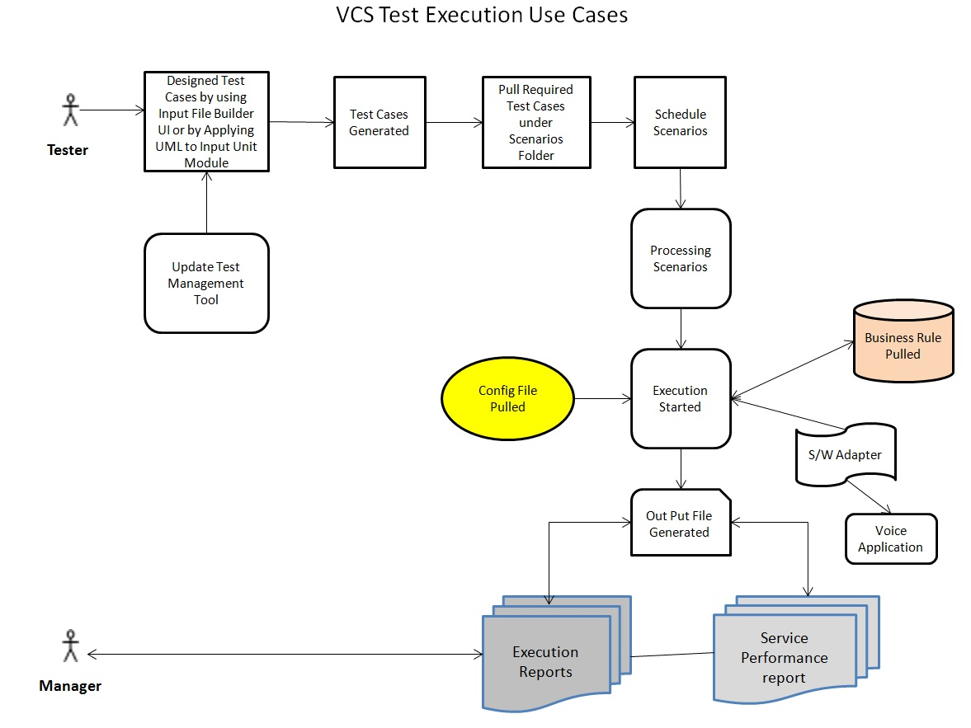
Syne User Management Test Execution Use Cases
Syne User Management Test Execution Use Cases gives you an idea for Tester and Manger role use cases.

Slide 35
Syne User Management Overview of Media Server Configuration
Course Content: (Session 5)
Introduction to Syne User Management Media Server Configurations
Media sever location is configured in Syne User Management Server and Syne User Management Rule Engine in configuration file
Syne User Management Overview of Environment Config
Correlation between Syne User Management, Media server and Audios
Call Type logging / Reporting
Reporting Server

Slide 36
Introduction to Syne User Management Media Server Configurations
Identifying Path
Normal Path :<Server>/Media/<ENV>/<LANG>/App/<category>/
B Path audios :<Server>/Media/<ENV>/<LANG>/<ClientCode>/App/<category>/
Common Audio : <Server>/ <ENV>/<LANG>/sys (Only use for Syne User Management default)
Media sever location is configured in Syne User Management Server and Syne User Management Rule Engine in configuration file
\\<VXMLServerIP>\VXMLSever\Conf\<ENV>_clientAudiumPrefs.xml
Entry name : <entry key="DEFAULT_AUDIOPATH" value="http://Syne User Management/Media/" />
Note: Media is VIP Name configured on GW to point to the media server of each site.
Categories
App/FE/ : This folder will contain almost all audio scripts
App/UI/ : This files file that are managed via Move File tab
App/RA/ : This contain Roadside Assistant/ few Cable Clients audios

Slide 37
Syne User Management Overview of Environment Config
Total 45 Syne User Management Application, Each environment has a relevant naming of the apps.
Dev_FE_XX
Test_FE_XX
Prod_FE_XX
Category of Syne User Management application : Initial application, Functional application
Initial Application: Based on the client TFN , following application are the entry point in the Syne User Management
FE_InitialApp, FE_InitialApp_RA, FE_InitialApp_CC, FE_InitialApp_Interaction
Functional Application : Application doing specific functionality in the Voice callflow e.g. Play menu/ Speakit , Checkin , Payment , Enrollment, shipping, Return Instructions, ATAC Flow, Call Transfer Flow.
Functional sections are also grouped based on Client specific Features or Generic features
Generic Functional Module ,FE_FN_Shipping, FE_FN_IS_ATAC_Triage, FE_FN_CSR_Transfer , FE_FN_DDM_DTFM_Menu etc.
Client Specific Functional Module , FE_FN_BMI_StartClaim_CheckIn, FE_FN_ERP_Enrollment, FE_FN_ERP_FraudCheck, FE_FN_ EMP_ReplaceRequest, etc.

Slide 38
Correlation between Syne User Management , Media server and Audios
How Syne User Management plays an Audio file
The VoiceXML Gateway interprets VXML pages generated by Syne User Management Server. The pages contain the audio file URLs that the GW uses to retrieve, cache and play the .wav files.
If media file not available on server or not accessible , VXML gateway looks for alternate option of Text to Speech (TTS) and if it is found then send request to TTS server to receive an audio content of that text input.
If the audio file and the equivalent text script are not available, GW throws no resource error.
Media Files properties
Format : Wave
Format profile : U-Law
Codec ID/Hint : CCITT
Bit rate : 64.0 Kbps
Channel(s) : 1 channel (mono)
Sampling rate : 8 000 Hz (8Khz)
Bit depth : 8 bits
Audios configurations
In Syne User Management application elements (audio, menu etc )
In Client Callflow XML (Messages , Speakit,
Menu .)

Slide 39
Call Type logging / Reporting
How CallTypes / Peg logging works
Call types are 4 digit value used to identify the touch-point in VSS client flow
Syne User Management application logs the calltypes based on the caller traversal in the Voice flow.
Syne User ManagementApp → ReportAction.aspx →VoiceWCFUtility Service → async call to DB SP iActionLog →Syne User ManagementUtilsConfig.ActionLog table
Caller Activity can be traced by querying specific calltypes.
Calltypes logging also help to save the notes for notifications in iCare (CSR UI) .
The other critical information like VXML Server IP, transfer label, PCC, HOO flags, ANI, MDN, ClaimId, Input selction in Menu etc are also saved against specific calltypes in ActionLog table.
Some Important Parameters to understand for tracking calltypes
Syne User ManagementCallId, RouterCallKey, RouterCallDay, Outcome, CallPathIndicator
Database for Calltypes
QA : QADB03\SQL2005\Syne User ManagementLogging\ActionLog
PROD: ndcsunSyne User Management001sg2\adhoc\Syne User ManagementUtilsConfig.ActionLog

Slide 40
Reporting Server
New generation logging : Reporting Server
The reporting service receives event messages from the VXML server and writes this data to the Informix reporting database. This is a Cisco provided reporting feature that being implemented in our Prod env. This reporting database contains complete caller traversal across the applications for any given call. The plan is to replace the search for call records from the large flat files by queries to this table.
Syne User Management application logs are maintained in flat files (Syne User Management Application logs), Flat Text file containing details information of caller activity, Syne User Management elements And Reporting Server which contains All events, caller activity , Syne User Management element logs
Advantages :
Logs maintained for reporting server in Informix DB which is easier to search.
Easier access to the logs over conventional flat file logging.
Easier integration with the Reporting tools and templates to monitor historical and real time reports
Reporting data includes call activity summary information, which assists call center managers in reviewing and managing daily operations. It can also include operational detail data for the Syne User Management applications.

Slide 41
Syne User Management Framework Modules, Feature Customization, & Live Demo
Course Content: (Session 6)
Remarkable features of Syne User Management Module along with example
Syne User Management Framework Module Customization
Syne User Management E2E demo
Audio Issues in QA
Common issues
Corrupted Audio files / bad fetch
Permissions Issue while reading audio files.
Typical Test Errors
Typical Test Errors Messages
Manual Testers Contribution for Automation Efforts
Voice Script Generation Tool
Role Definitions and Benefits
Benefits and Future plan

Slide 42
Remarkable features of Syne User Management Module along with example
Compatible with different input format
Automatic scripts sync-up according to business rule change
Re-usable function library
Adhered all coding standards
Built in business template cases for rapid style script development
Easily grafted with different platform
Thread safe i.e. multiple business test cases execute independent of each other
Extensibility and Maintenance Friendly

Slide 43
Syne User Management Framework Modules - Customization
Procedure to handle error scenarios by designing with the help of Input Test Script File/Builder
How to modify Rule engine according to new business case?
How Syne User Management Framework communicate with Test Script UI tool?
Customization of Input file
Customization of Reports

Slide 44
Syne User Management E2E demo
Live demo by executing one of the client
Practical session on module customization and couple of clients E2E execution
Troubleshooting session
Challenges and their solutions

Slide 45
Audio Issues in QA
Common issues
Media Server Play Old files
Happens only for the same name of audios that already in use
VXML gateway didn’t find the Modified date of the new audio file greater that the current audio file’s created date/ Modified Date.
VXML gateway catches a old copy of audio files.
Solutions :
Always update the Audio of same name with the latest modified date and ensure that Modified date should be greater than existing prod audio
Corrupted Audio files / bad fetch
Audio File format is not correct, we should always check for the media files properties for the Syne User Management specified format. (8 Bit , 8 Khz, Single-monoi –ulaw .wav)
Permissions Issue while reading audio files.
Sometime while moving audio file to media server we face this issue that security and access permissions are not provided to audio files , this leads to no-resource error from Syne User Management, this is rare case where deployment team need to fix the permissions.

Slide 46
Typical Test Errors
Environment is down
CIRTs
Hotfixes
Show stoppers
LIVE mode vs. Stub mode
MDN/SKU issues
Incorrect COP selected
Inventory issues in DAX
Incorrect service version in Service Config File
Incorrect queue
Missing or incorrect node
Time out / Replay
Data sheet missing

Slide 47
Typical Test Errors Messages
Run Error: Cannot open database "QADataPrep" requested by the login. The login failed.
Function file: [QualityCenter] Subject\QA Services\aFunction Library\fl_Global.vbs
Line (25498): " objConnection.Open "Server=" & strServer & ";Database=QADataPrep;Trusted_Connection=yes"".
Verison number can not be found due to an invalid input parameter, please re-check parameters
<?xml version="1.0" encoding="UTF-8"?><ns0:ProcessReplacementEquipmentResponse xmlns:ns0="http://services.client.com/schemas/ProcessReplacementEquipmentResponse/1.0.2"> <ns1:Errors xmlns:ns1="http://services.client.com/schemas/clientCanonicalModel/2.0.0"> <ns2:Error xmlns:ns2="http://services.client.com/schemas/Errors/1.0.0"> <ns2:ErrorType>Application</ns2:ErrorType> <ns2:ErrorNumber>1</ns2:ErrorNumber> <ns2:ErrorMessage>Error in the JMSProcessReplacementEquipment Service: A validation occurred while parsing: validation error: unexpected content "{http://services.client.com/schemas/ProcessReplacementEquipmentRequest/1.0.1}IsAvailableForBackorder"; expected
File \\nasappfp01\IT\IT_QA_Test\QATest_Data\CS\305268\ not found

Slide 48
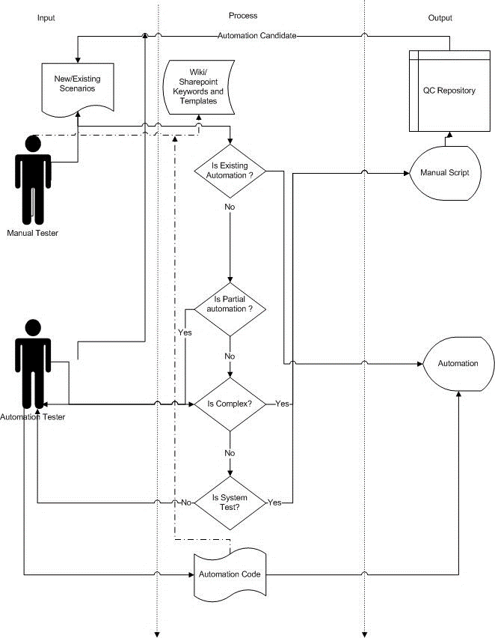
Manual Testers Contribution for Automation Efforts

Slide 49
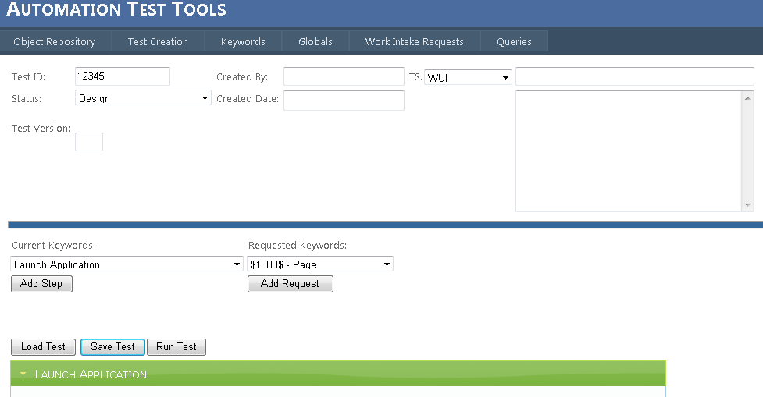
Voice Script Generation Tool
Utility URL:
http://nprlabsqa5332/Syne User ManagementTool/Object_Repository.aspx
Features :
Test Script Creation
Adding an Object to Object Repository
Adding Key words
Adding ,Updating and Deleting Queries
Storing Global
Intake request

Slide 50
Role Definitions and Benefits
Role Definitions
Manual Tester– creates the actual Keyword driven test cases in a spreadsheet,
including pre- and post-conditions and Keyword parameters. This role will be
played by a non-technical subject matter expert / business user
Automation Tester– maintains the core framework and enhances the same
for any new customizations or enhancements. This role is a technical person and
is well versed with coding and the scripting language referred by tool
Benefits
Automation utilization and coverage
Extend system test automation upto 40 to 50%
Execution effort will be less
Example- Single script can be used for multiple client (north America)

Slide 51
Benefits and Future plan
Compatible with different input formats
Automatic scripts sync-up according to business rule change
Re-usable function library
Adhered all coding standards
Built in business template cases for rapid style script development
Easily grafted with different platform
Thread safe i.e. multiple business test cases execute independent of each other
Extensibility and Maintenance Friendly
Easily move on freeware or cost effective tools
No licensing fee. Can be used widely by SQA as well as Dev team members on Dev Int env
Supports multiple testing frameworks
Various testing supported by framework, such as Functional, Regression and Database Validation testing etc
Built in business template cases for rapid style script development

Slide 52
Q&A

Slide 53
Thank You!

